Slide 1
Comparing Ridership Traffic during/pre Pandemic Period
MTA Exploratory Data Analysis

Slide 2
Backstory:
MTA gives out free masks and installs hand sanitizers throughout different stations. They want to know the busiest stations by different time of the day so they can effectively allocate the hand sanitizers/masks in different stations and know the best time to replenish masks/hand sanitizers.
Approach:
Examine the MTA turnstile data to figure out busiest station throughout different time frame (06:00-14:00 / 14:00-22:00 / 22:00-06:00).
Data Used:
Jan.2021-Apr.2021 & Jan.2018-Apr.2018 : http://web.mta.info/developers/turnstile.html

Slide 3
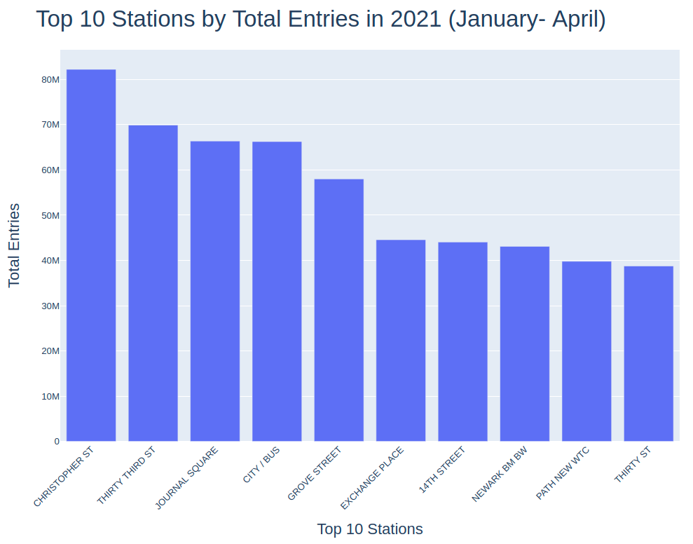
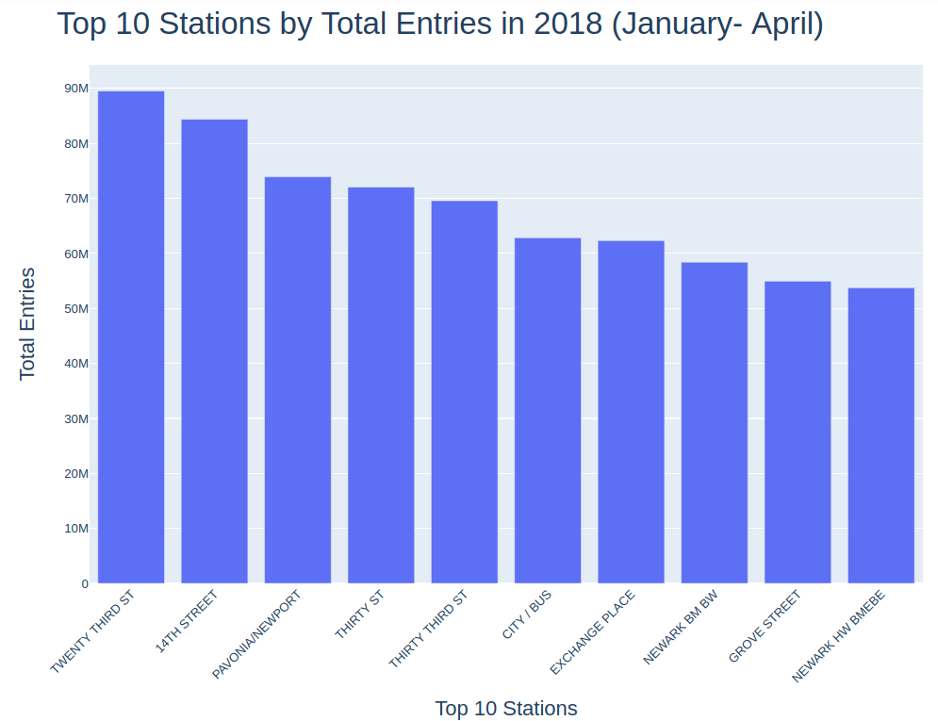
During Covid
Pre-Covid
Decrease in Ridership overall from 2018 → 2021
Top 10 Stations varied over the year
7 overlapping Stations

Slide 4
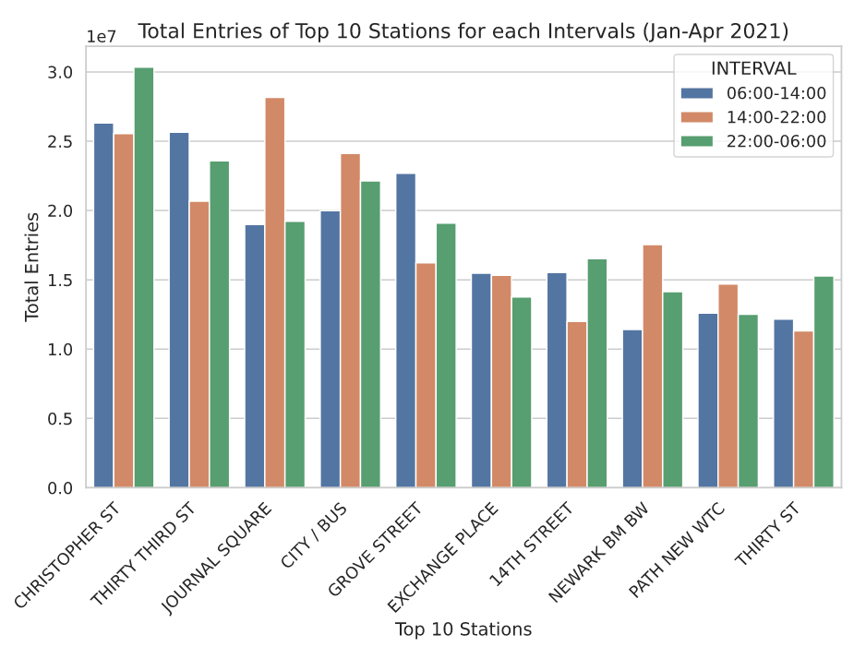
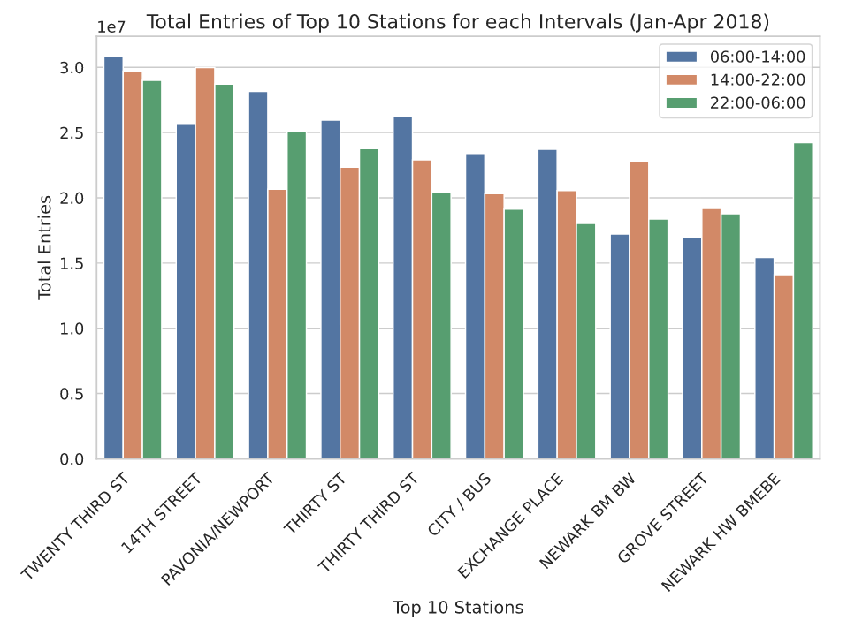
Jan - April 2021 Data
Jan - April 2018 Data
Not a definite repeating pattern, but morning commute time mostly busy in 2018, but not for 2021 - potential effect of COVID? Remote work, avoiding public transportation...etc
Night time(22:00-06:00) expected the lowest for all, but not as expected

Slide 5
Conclusion/Insights
Overall decrease in total entries during the covid period. Morning commute is no longer the most busiest time of the day in 2021.
Busiest time in 2021 shifted to 14:00-22:00 / 22:00-06:00.
Irregularity + Future Development
Look deeper into the Night Time(22:00-06:00) interval to see what is going on.
According to MTA site, subway doesn’t operate from 02:00-04:00 AM. Yet, the night time interval does not show consistent lowest entries.
Bring in data of masks distributed or amount of hand sanitizer used in each station and find correlation.

